Slide 1

FEATURE EXTRACTION AND PRICE PREDICTION for MOBILE PHONES
A PROJECT BY
NEXTHIKE IT SOLUTIONS
By Mr. Ajay Kumar Sahu

Slide 2


PROBLEM STATEMENT
Objective:
To analyze mobile phone specifications and their impact on Price.
To perform Exploratory Data Analysis (EDA) for better understanding.
To identify important features affecting mobile price.
To apply feature engineering and encoding techniques.
To build machine learning models for price prediction.
To evaluate model performance using suitable metrics

Slide 3
PROBLEM STATEMENT
Challenges:
  Understanding dataset structure and feature types.
  Handling categorical variables for machine learning models.
  Deciding whether to remove or keep outliers
  Selecting the right machine learning model.
  Interpreting model performance metrics (R2 score, Mean Absolute Error (MAE), Mean Squared Error (MSE).
  Identifying the most important feature affecting price.

Slide 4
PROBLEM STATEMENT
Business Impact:
Helps companies predict mobile prices accurately.
Identifies key features influencing pricing.
Supports data-driven decision making.
Assists in product design and feature selection.
Improves pricing strategy and market competitiveness.

Slide 5

Data description
The dataset contains mobile phone specifications such as:
Model
Colour
Memory
RAM
Battery Capacity
Rear Camera
Front Camera
AI Lens
Processor
Mobile Height
Target Variable: Prize (Mobile Price)
Dataset includes both numerical & categorical features
NextHikes IT Solutions

Slide 6
DATA EXPLORATION
Loaded the dataset using Pandas:
pd.read_excel
Checked dataset structure using:
  df.head()- By default, it display first five rows and it will always display from the starting only
  df.info()- It will give us the complete info of the data frame.
  df.describe()- It will give us the statistical info of the data frame.
Goal:
  Understand features, data types, and dataset structure.
NextHikes IT Solutions

Slide 7
MISSING VALUE CHECK
Checked whether dataset contains missing values:
df.isna().sum()- It displays column wise count of missing values
Result:
No missing values found, so no imputation was required.
NextHikes IT Solutions

Slide 8
IDENTIFY FEATURE TYPES
Separated variables into:
Numerical Features- Memory, RAM, Battery, AI Lens, Mobile Height, Prize
Categorical Features- Model, Colour, Rear Camera, Front Camera, Processor
This helped determine appropriate EDA and encoding techniques.
NextHikes IT Solutions

Slide 9

Data Cleaning & Preprocessing
Total Records:
541 Rows and 12 Columns
Features:
Memory, RAM, Battery, AI Lens, Mobile Height, Prize, Model, Colour, Rear Camera, Front Camera, Processor
Feature Types: Numerical and Categorical

Slide 10
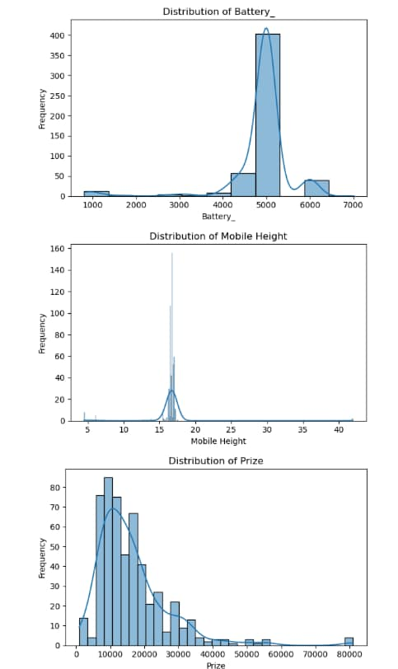
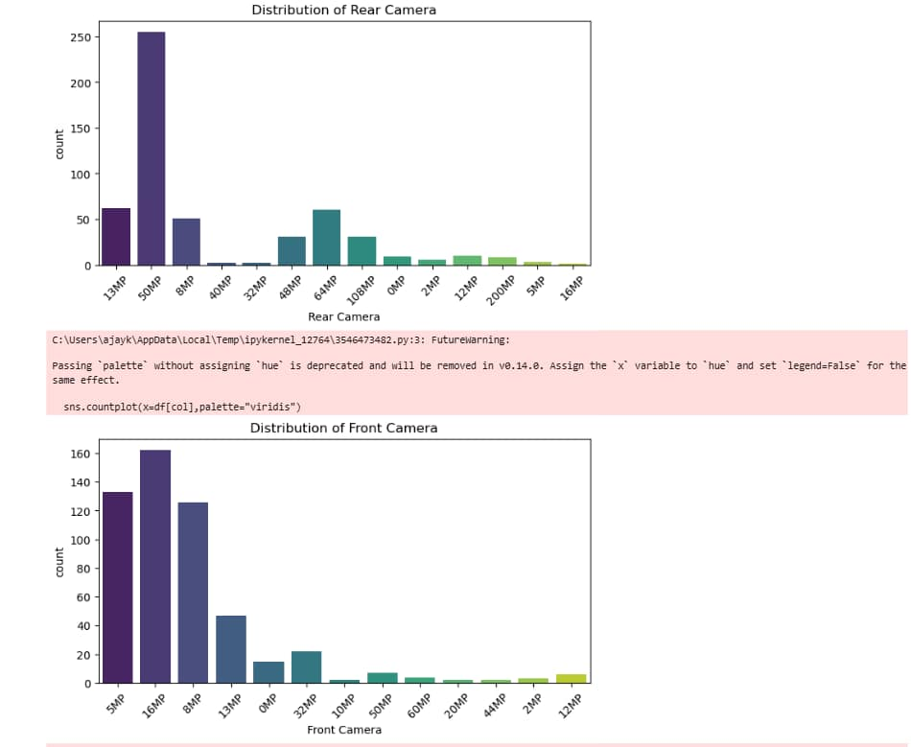
Exploratory Data Analysis (EDA)
Univariate Analysis:
Analyzed individual feature distributions.
Used:
  Histograms for numeric variables
  Count plots for categorical variables
Goal:
  Understand data distribution and detect anomalies.

Slide 11
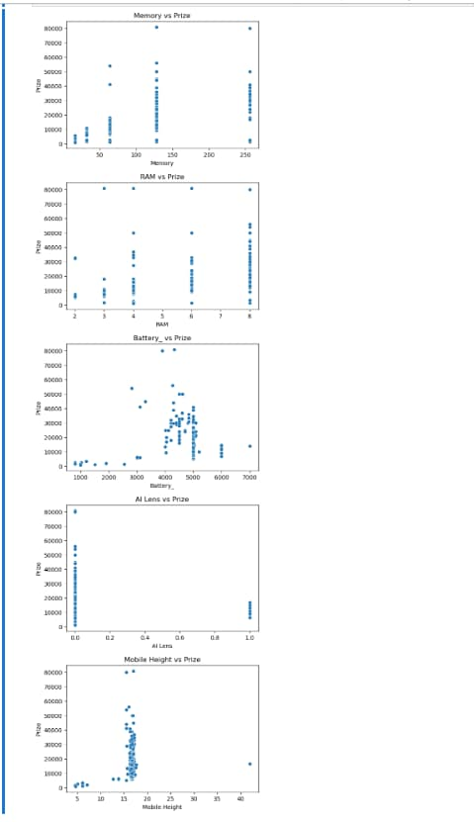
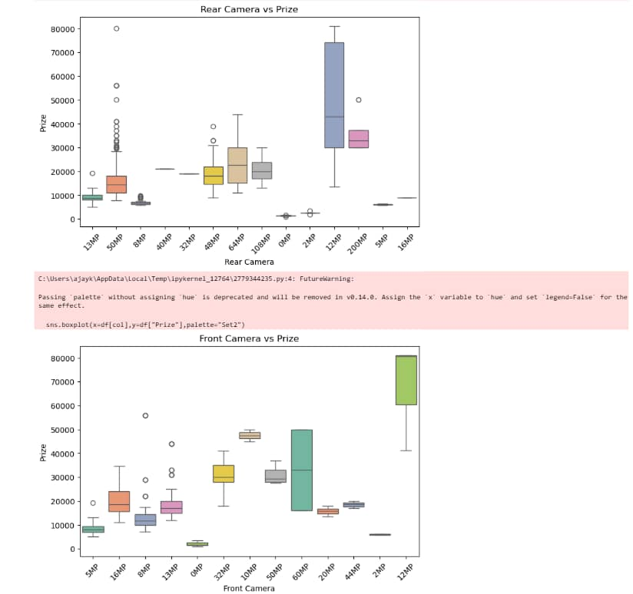
Exploratory Data Analysis (EDA)
Bivariate Analysis:
Analyzed relationships between features and target variable (Prize).
Used:
  Numeric vs Prize → Scatter plots
  Categorical vs Prize → Box plots
Goal:
  Identify features influencing price.

Slide 12
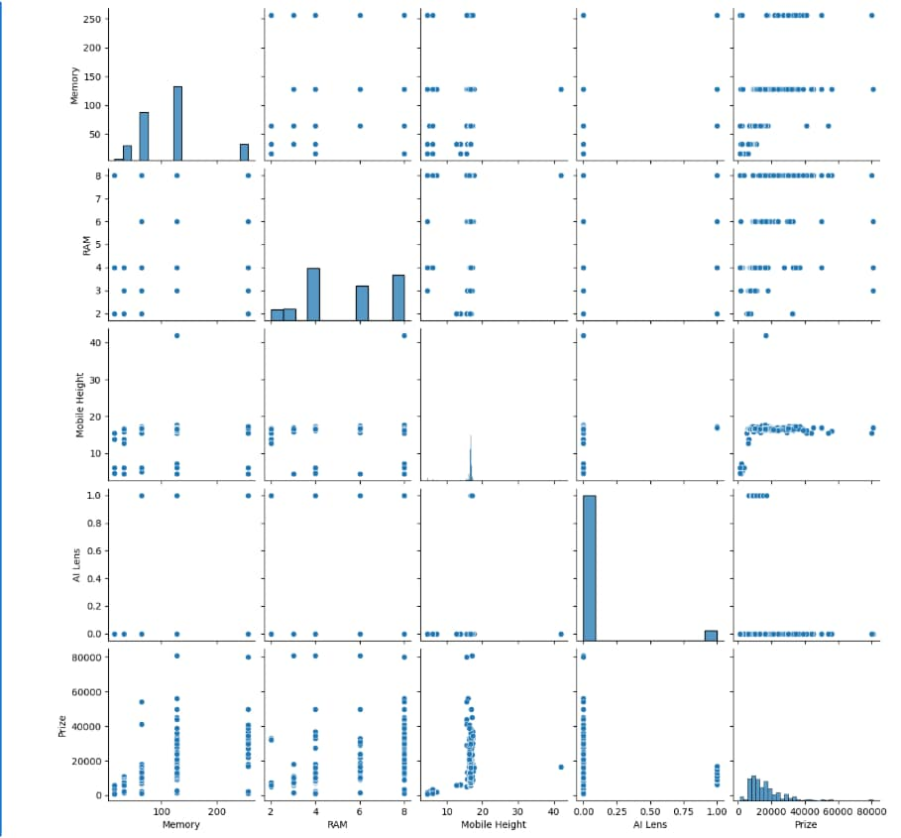
Exploratory Data Analysis (EDA)
Multivariate Analysis:
Select top important numerical features.
Used pairplot to visualize relationships.
Shows:
  Relationship between feature pairs
  Distribution of each features
Goal:
  Helps understand interaction between variables.
  Supports better feature selection and modeling.

Slide 13
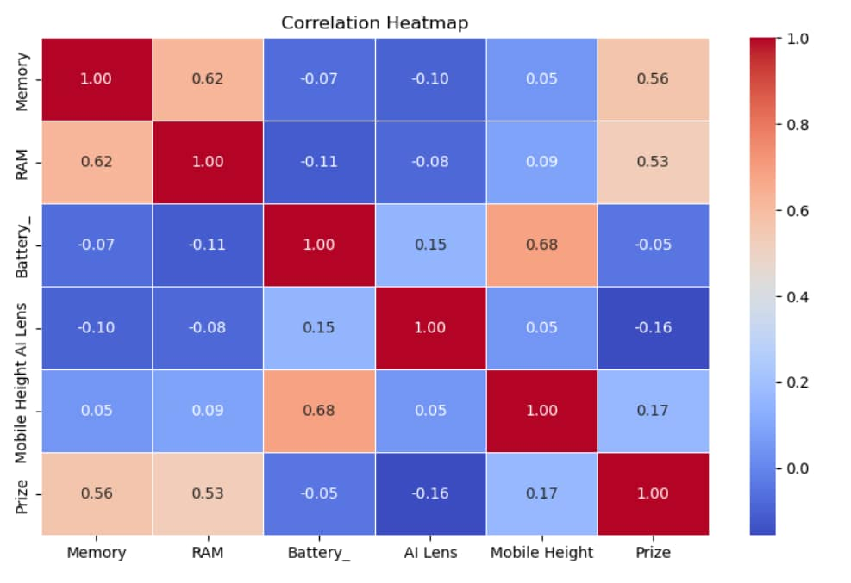
Exploratory Data Analysis (EDA)
Correlation Analysis:
Analyzed relationship between numerical features and Prize.
Generated correlation matrix and heatmap.
Correlation values range from -1 to +1
Helps identify:
  Strong positive correlation
  Strong negative correlation
Goal:
  Useful for feature selection and model building.

Slide 14
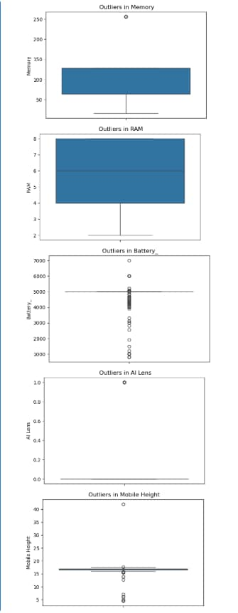
Exploratory Data Analysis (EDA)
Outlier Detection:
Outliers are extreme on unusual values in the dataset.
Detected outliers using boxplots.
Observed presence of outliers in numeric features.
Outliers were kept because they presents real-world mobile specifications.
Memory : 55 outliers
RAM : 0 outliers
Battery_ : 148 outliers
AI Lens : 34 outliers
Mobile Height : 32 outliers

Slide 15
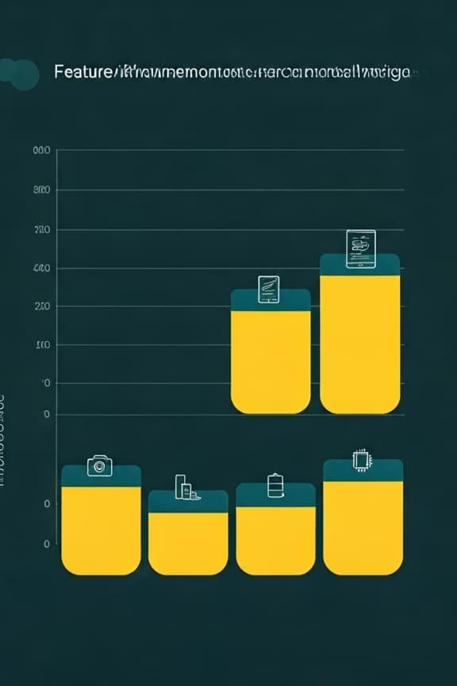
Feature Engineering
Feature Encoding:
  Machine learning models require numerical data.
  Categorical variables converted to numeric format using One Hot Encoding
  Created new binary (0/1) columns for each category.
  This allows machine learning algorithms to process categorical data.
NextHikes It Solutions

Slide 16
TRAIN TEST SPLIT
Dataset split into training and testing sets:
  Training Set (80%)
  Testing Set (20%)
Used train_test_split function.
Training data used to train the model.
Testing data used to evaluate model performance.
This helps evaluate model performance on unseen data.
NextHikes It Solutions

Slide 17
FEATURE SCALING
Applied StandardScaler to normalize numerical variables.
Applied StandardScaler:
  Mean= 0
  Standard Deviation= 1
This ensures features have similar scale for model training.
NextHikes It Solutions

Slide 18
MODEL BUILDING
Built machine learning models to predict Prize.
Models used:
  Linear Regression
  Random Forest Regressor
Trained models using training data.
Goal:
  Predict mobile phone prices.
NextHikes It Solutions

Slide 19
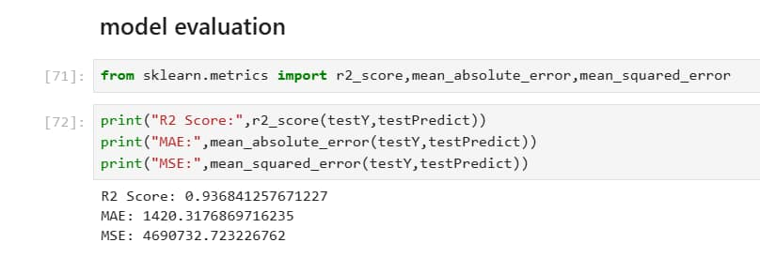
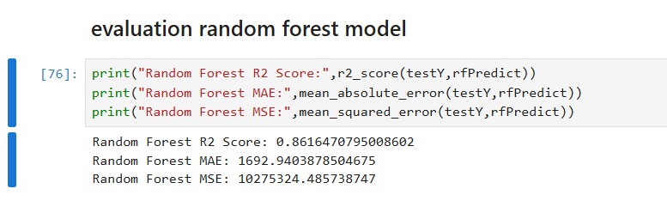
Model Evaluation
Model evaluated using:
Linear Regression R2 Score- 0.936841257671227
Linear Regression Mean Absolute Error (MAE)- 1420.3176869716235
Linear Regression Mean Squared Error (MSE)- 4690732.723226762
Random Forest R2 Score- 0.8616470795008602
Random Forest MAE: 1692.9403878504675
Random Forest MSE: 10275324.485738747
Compared performance of:
  Linear Regression
  Random Forest
Linear Regression achieved higher R2 Score
Selected as the best model
NextHikes It Solutions

Slide 20
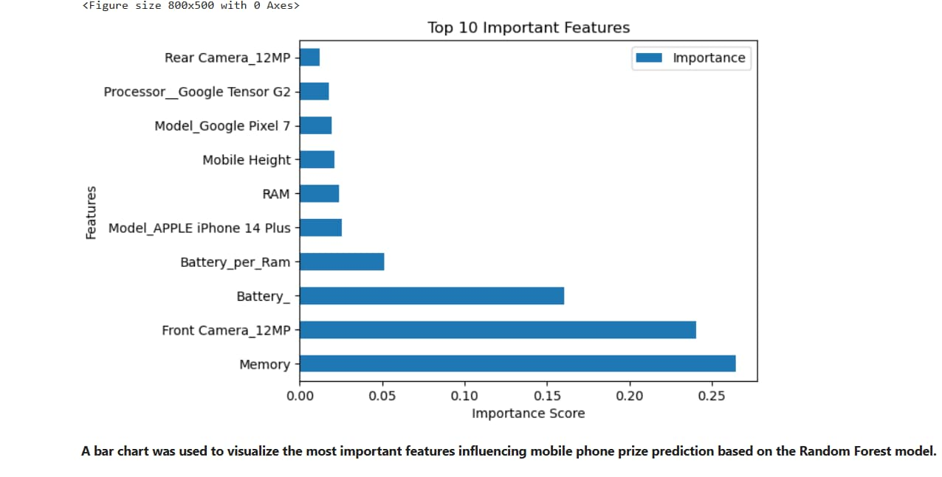
Feature Importance
Random Forest model used to calculate feature importance.
Identifies most important features affecting prize.
Each feature assigned an importance score
Higher Score→ greater impact on price
This helps identify which features most influence price
NextHikes It Solutions

Slide 21
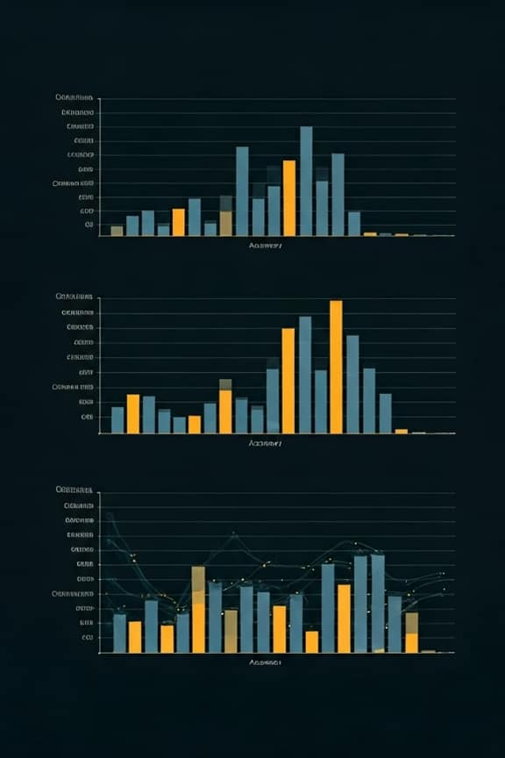
Model Comparison
Performance Metrics (R2 Score):
R2 Score- 0.936841257671227
Mean Absolute Error (MAE)- 1420.3176869716235
Mean Squared Error (MSE)- 4690732.723226762
Random Forest R2 Score- 0.8616470795008602
Random Forest MAE: 1692.9403878504675
Random Forest MSE: 10275324.485738747
Why Linear Regression?
Achieved higher R2 score compared to Random Forest.
Shows strong linear relationship between features and price
Simple and easy to interpret
Less risk of overfitting
Performs well on this dataset
NextHikes It Solutions

Slide 22
VISUALIZATION
Used Visualizations to understand data and model performance:
  Correlation Heatmap
  Feature Importance Plot
  Actual vs Predicted Plot
  Residual Plot
  Actual vs Predicted Line
Helps in better understanding and interpretation of results
NextHikes It Solutions

Slide 23
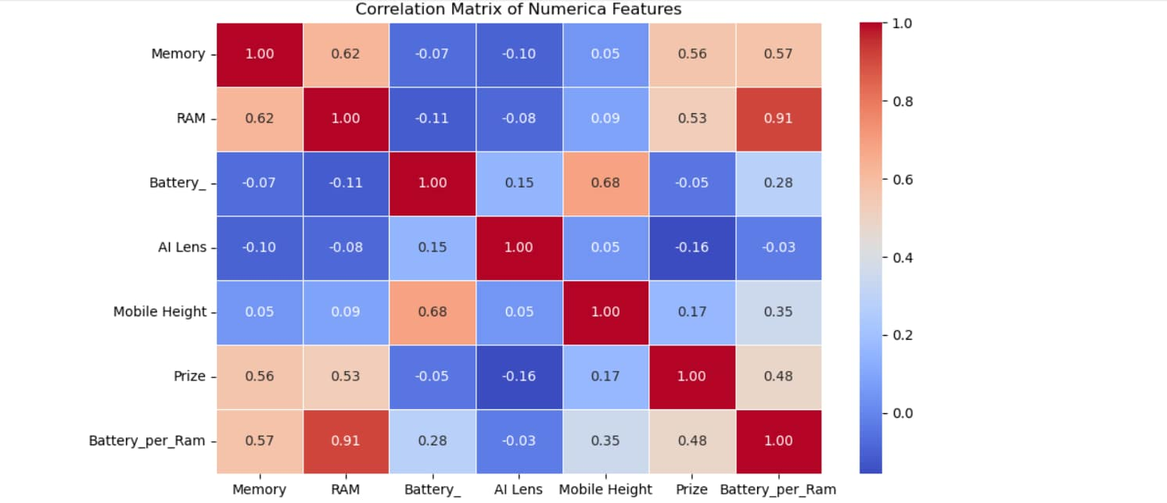
CORRELATION hEATMAP
A correlation matrix was created to analyze the relationships between numerical variables in the dataset. Since correlation can only be calculated for numeric data, only numerical features were selected for this analysis. The heatmap visualization helps identify variables that have strong positive or negative relationships with the target variable (Prize).
NextHikes It Solutions

Slide 24
FEATURE Importance plot
A bar chart was used to visualize the most important features influencing mobile phone prize prediction based on the Random Forest model.
NextHikes It Solutions

Slide 25
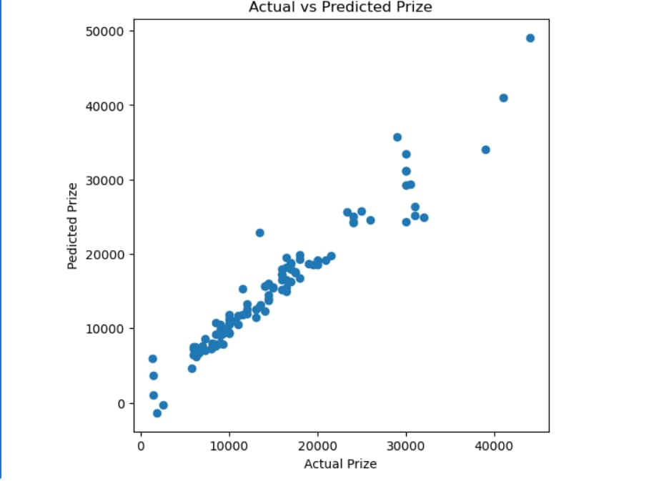
ACTUAL VS PREDICTED PLOT
A scatter plot was used to compare the actual prize values with the predicted values from the model. Points close to the diagonal indicate accurate predictions.
NextHikes It Solutions

Slide 26
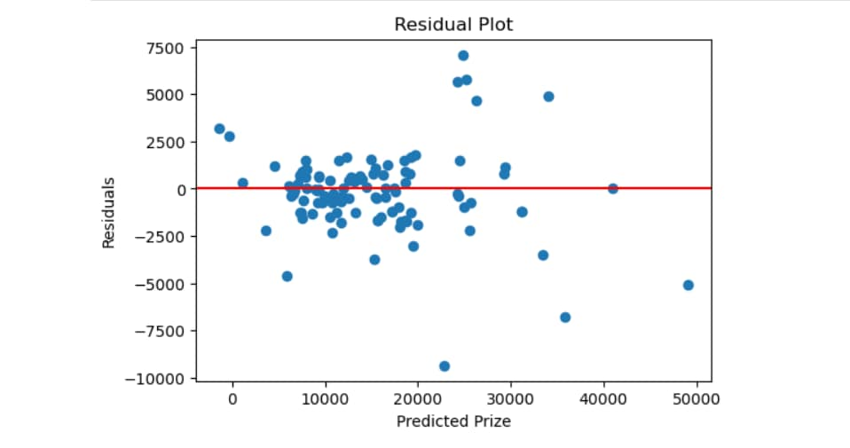
RESIDUAL PLOT
A residual plot was used to evaluate the model's prediction errors. Residuals represent the difference between the actual and predicted prize values. Ideally, the residuals should be randomly scattered around the horizontal zero line. This indicates that the model errors are randomly distributed and the model fits the data well.
NextHikes It Solutions

Slide 27
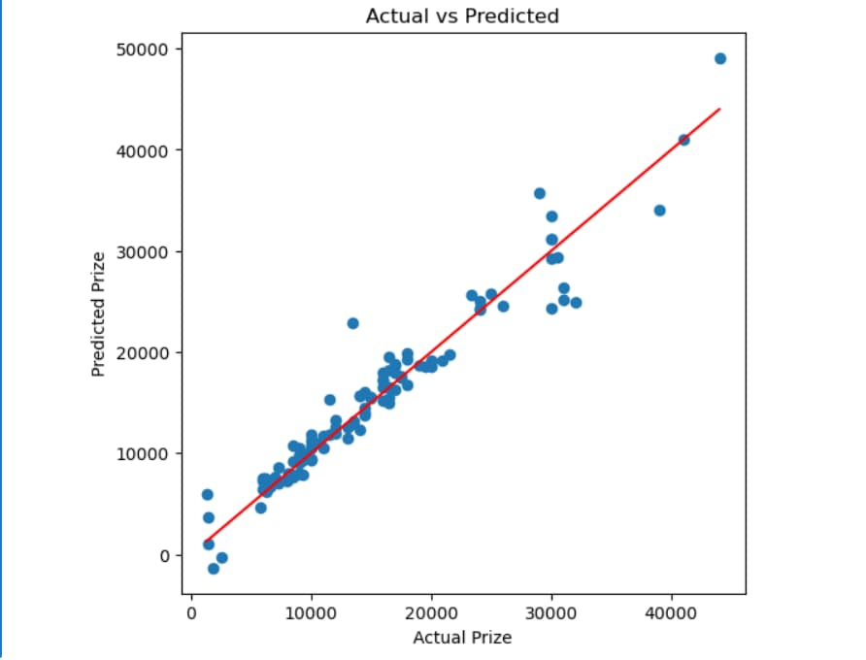
ACTUAL VS PREDICTED LINE
The scatter plot compares the actual and predicted prize values. The red diagonal line represents perfect predictions. Points close to this line indicate that the model predictions are accurate.
NextHikes It Solutions

Slide 28
Conclusion
The machine learning model successfully predicted mobile phone prices.
Performed data analysis and feature engineering.
Linear Regression achieved the best performance.
Identified important features affecting price.
Model shows good accuracy and reliability
NextHikes It Solutions

Slide 29
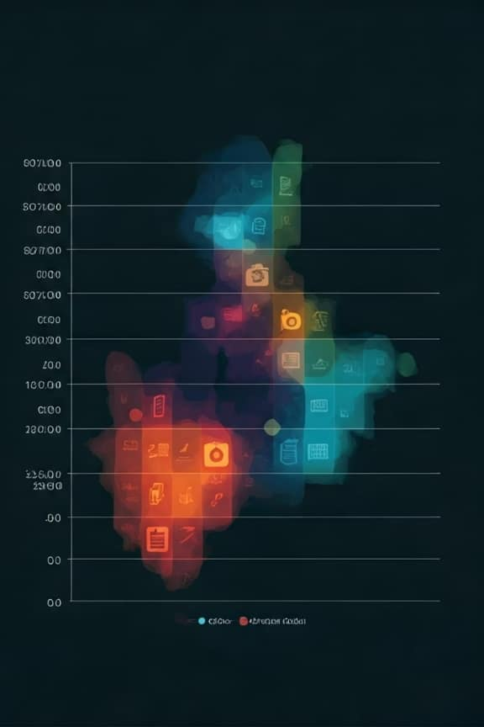
Business Insights
Business Recommendations:
Focus on key features like:
  RAM
  Battery Capacity
  Processor
  Camera
Use data-driven approach for pricing strategy.
Optimize product design based on important features.
Improve competitiveness in the market.
Use predictive models for better decision-making.
NextHikes It Solutions

Slide 30

THANK YOU
Grateful for your time and attention.
Your feedback and insights are deeply appreciated!
Mr. Ajay Kumar Sahu
ajaykumarsahu2017.1997@gmail.com

